Slide 1
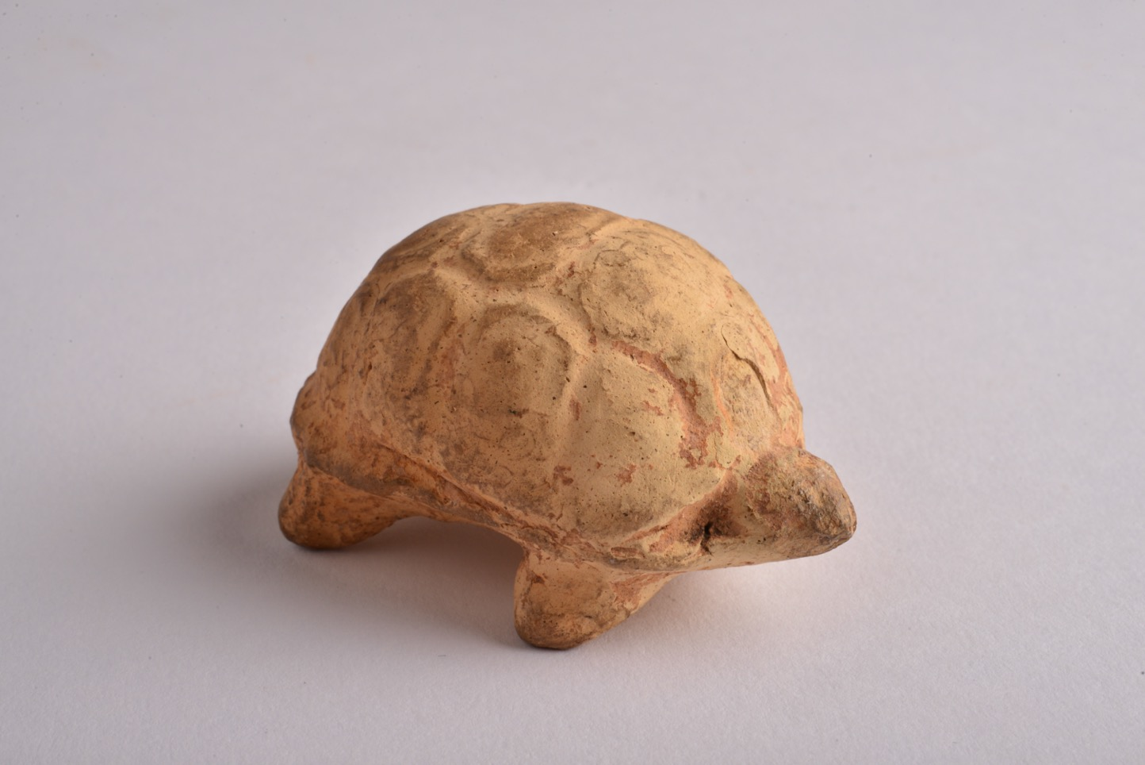
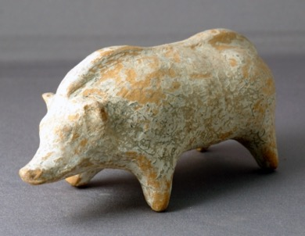
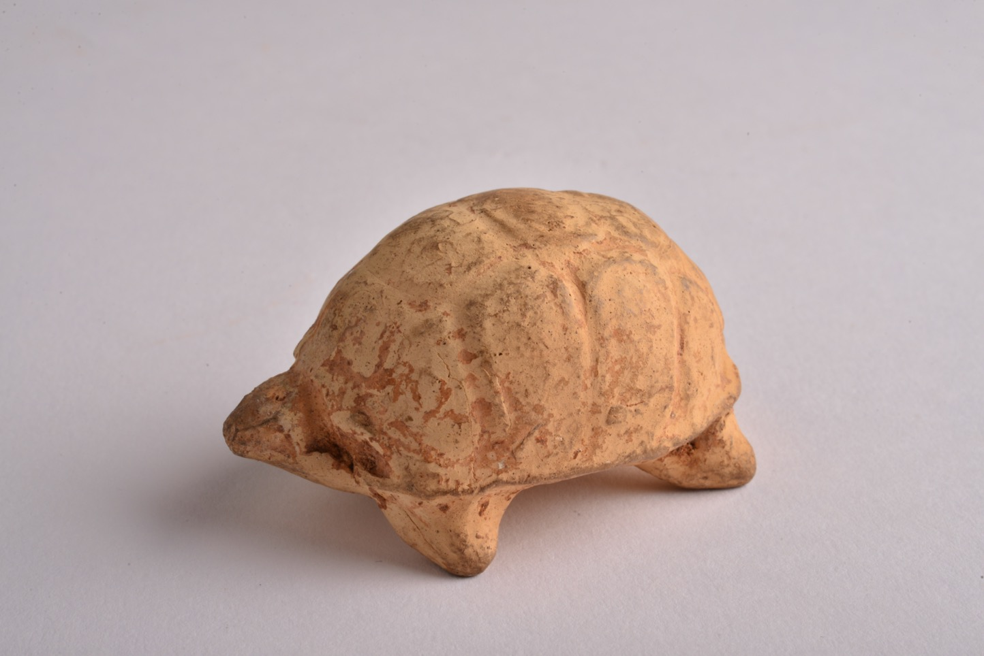
PLAYING Children in Ancient Greece

Slide 2
Boar (231)
One artefact we are looking at today is a small figurine in the shape of a boar (a type of wild pig).
Little figurines like this one could be children’s toys.
231 is the boar’s accession number – this is the special number used (like a name) to identify the boar in the Great North Museum: Hancock.

Slide 3
Boar (231)
The boar was made in Greece between 480 and 323 BCE – so around 2500 years ago.
The boar is made from clay. It was made in a mould and then fired in a kiln (a very hot oven).

Slide 4
Tortoise (176)
Another artefact we are looking at today is a small figurine in the shape of a tortoise.
Little figurines like this one could be children’s toys.
176 is the tortoise’s accession number – this is the special number used (like a name) to identify the tortoise in the museum.

Slide 5
Tortoise (176)
The tortoise was made in Greece between 480 and 323 BCE – so around 2500 years ago.
The tortoise is made from clay. It was made in a mould and then fired in a kiln (a very hot oven).

Slide 6
Using Toys Playing in Ancient Greece
You can see that the boar and the tortoise toys are like toys and models we can buy today.
The modern toys are made from plastic, whilst the ancient Greek toys are made from clay, but otherwise they are similar, aren’t they?
What types of games could you play with animal model toys like the boar and the tortoise?

Slide 7
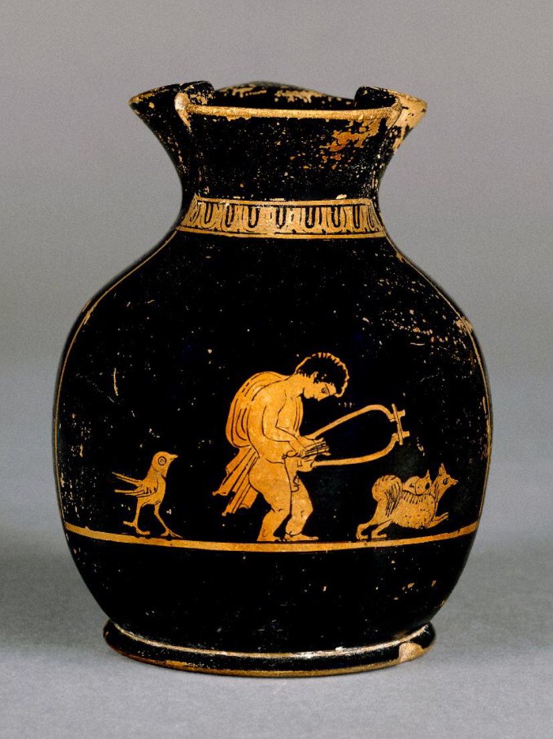
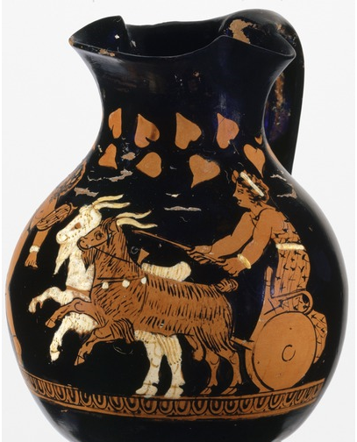
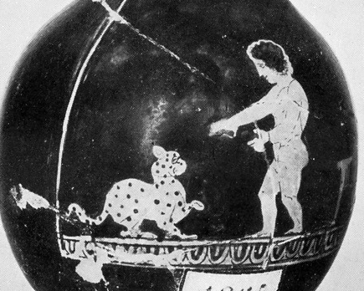
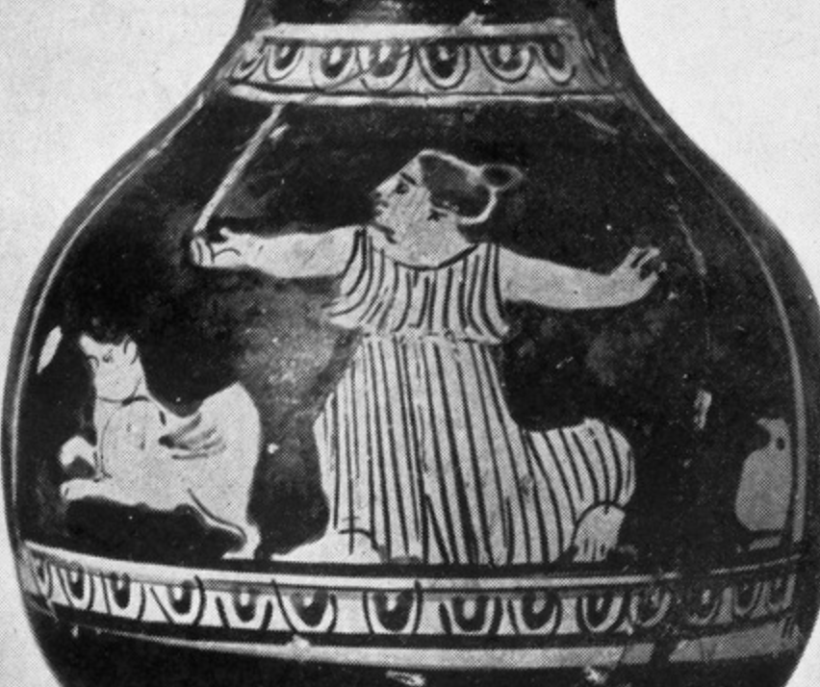
These pictures show little jugs from ancient Greece. The jugs are called choes and they often belonged to children. The pictures on them often show children playing, with different animals.
More Animals
Which animals can you see?

